Slide 1
Gas and Oil Leakage Detection System (GOLDS):
Ensuring Safety, Environmental Protection, and Operational Integrity
JEGAN G - 210701521
RATHIDEVI J - 210701506
MONASHREE D - 210701165

Slide 2
01
ABSTRACT

Slide 3
ABSTRACT
The Gas and Oil Leakage Detection System (GOLDS) addresses the critical need for timely detection of leaks in oil and gas infrastructure. Using advanced sensors GOLDS provides accurate detection and rapid response to potential leaks. The system enhances operational efficiency and reduces maintenance costs through wireless sensor networks. Its scalability makes it suitable for various industrial applications, effectively safeguarding assets, protecting the environment, and ensuring regulatory compliance.

Slide 4
EXISTING SYSTEM
02

Slide 5
EXISTING SYSTEM
Existing systems for detecting gas and oil leakages typically rely on manual inspections, fixed sensors, and periodic maintenance checks. These conventional methods often suffer from delayed leak detection and limited coverage, leading to higher risks of undetected leaks, environmental damage, and safety hazards. Additionally, these systems lack real-time monitoring and advanced data analytics, resulting in less efficient risk management and increased operational costs.

Slide 6
03
PROPOSED SYSTEM

Slide 7
PROPOSED SYSTEM
The proposed Gas and Oil Leakage Detection System (GOLDS) leverages advanced sensors, and helps in accurate leak detection. GOLDS deploys wireless sensor networks for continuous data collection and analysis, enabling rapid response to potential leaks. This system enhances operational efficiency, reduces maintenance costs, and ensures scalability and adaptability for diverse industrial applications, thereby safeguarding assets, protecting the environment, and ensuring regulatory compliance.

Slide 8
04
SYSTEM ARCHITECTURE

Slide 9
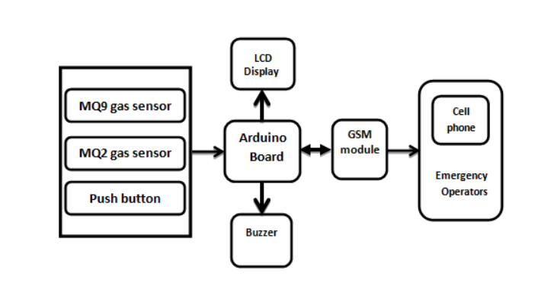
SYSTEM ARCHITECTURE

Slide 10
05
LIST OF MODULES

Slide 11
LIST OF MODULES
SENSOR MODULE
DATA ACQUISTION MODEL
DATA TRANSMISSION MODULE
DATA ANALYTICS MODULE
ALERTING MODULE
USER INTERFACE MODULE

Slide 12
06
FUNCTIONAL DESCRIPTION OF EACH MODULE

Slide 13
DESCRIPTION OF MODULE
1.SENSOR MODULE
The Sensor Module is responsible for collecting data from various sensors deployed within the oil and gas infrastructure. This module includes sensors such as flowsensors, gas sensor(M2Q) which monitor critical parameters related to gas and oil flow rates.

Slide 14
DESCRIPTION OF MODULE
2.DATA ACQUISTION MODULE
The Data Acquisition Module processes the raw sensor data collected by the Sensor. Module, converting it into digital format for further analysis. This module interfaces with the sensors and microcontrollers, ensuring reliable data transmission and synchronization.

Slide 15
DESCRIPTION OF MODULE
3.DATA TRANSMISSION MODULE
The Data Transmission Module facilitates the transmission of processed sensor data to the central monitoring system or cloud-based server for analysis and storage. This module utilizes wireless communication protocols such as Wi-Fi, LoRaWAN, or GSM to transmit data over long distances, enabling remote monitoring capabilities

Slide 16
DESCRIPTION OF MODULE
4.DATA ANALYTICS MODULE
The Data Analytics Module analyzes the transmitted sensor data in real time to detect anomalies indicative of potential gas and oil leakages. This module employs to identify deviations from normal operating conditions and trigger alert notifications.

Slide 17
DESCRIPTION OF MODULE
5.ALERTING MODULE
The Alerting Module is responsible for generating and transmitting alert notifications to relevant stakeholders in the event of detected anomalies or potential leakages. This module supports various notification channels, such as emergency calls ensuring timely response measures.

Slide 18
DESCRIPTION OF MODULE
6.USER MODULE
The User Interface Module provides a graphical user interface (GUI) for stakeholders to visualize sensor data. This module helps in decision-making.

Slide 19
IMPLEMENTATION
07

Slide 20
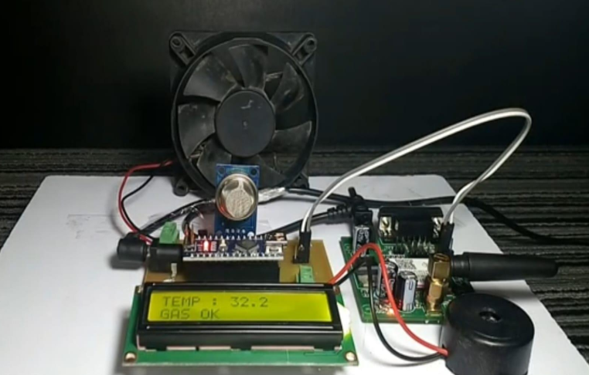
GAS LEAK DETECTION

Slide 21
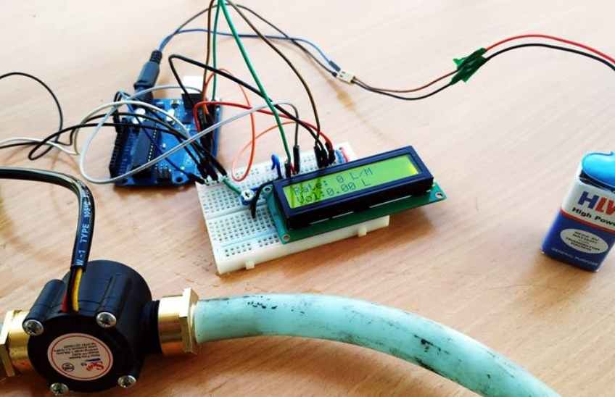
OIL LEAK DETECTION

Slide 22
CONCLUSION
07

Slide 23
CONCLUSION
The Gas and Oil Leakage Detection System (GOLDS) is a significant advancement in oil and gas infrastructure monitoring, offering a proactive and reliable solution for detecting and mitigating gas and oil leakages. Through IoT integration, advanced sensors, and real-time monitoring, GOLDS ensures robust functionality, accuracy, and scalability. Its rapid response times, remote monitoring capabilities, and scalability enhance risk management and operational efficiency. GOLDS improves safety, protects the environment, and supports regulatory compliance, contributing to a sustainable energy future. Continued refinement will further enhance its capabilities, solidifying its role as an indispensable tool for ensuring operational integrity and environmental stewardship in the oil and gas sector.

Slide 24
THANK YOU

